Slide 1
5G Edge Cloud

Slide 2


Team Members
Rahul Rajkumar
Andrew Michael

Slide 3
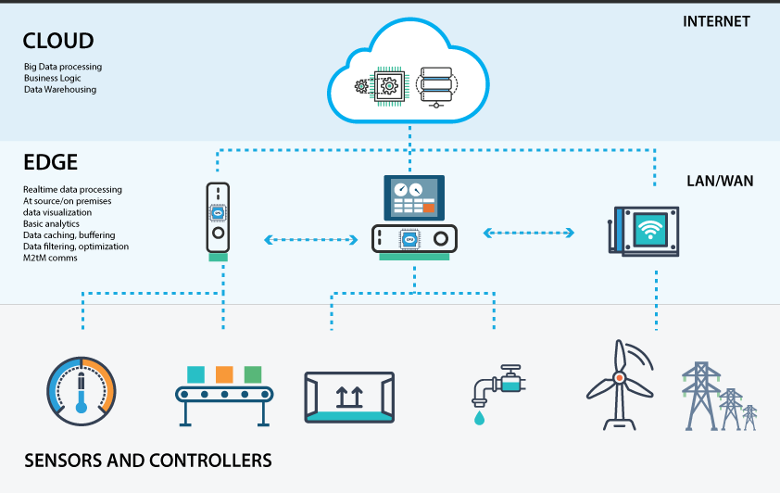
Edge
Computing done through nearby data sources
Reduces need for cloud trips
Notes:
Edge computing is very similar to cloud in the sense, it’s also for offloading compute but it runs applications close to where data is generated, like on devices or local servers. This reduces the need to send data to distant cloud servers, cutting down latency and bandwidth usage. It's ideal for real-time or bandwidth-sensitive tasks. It also considers security concerns.

Slide 4
Goal: Finding Benchmarks for Edge Computing Platforms
Notes:
Goal (say it out load)

Slide 5
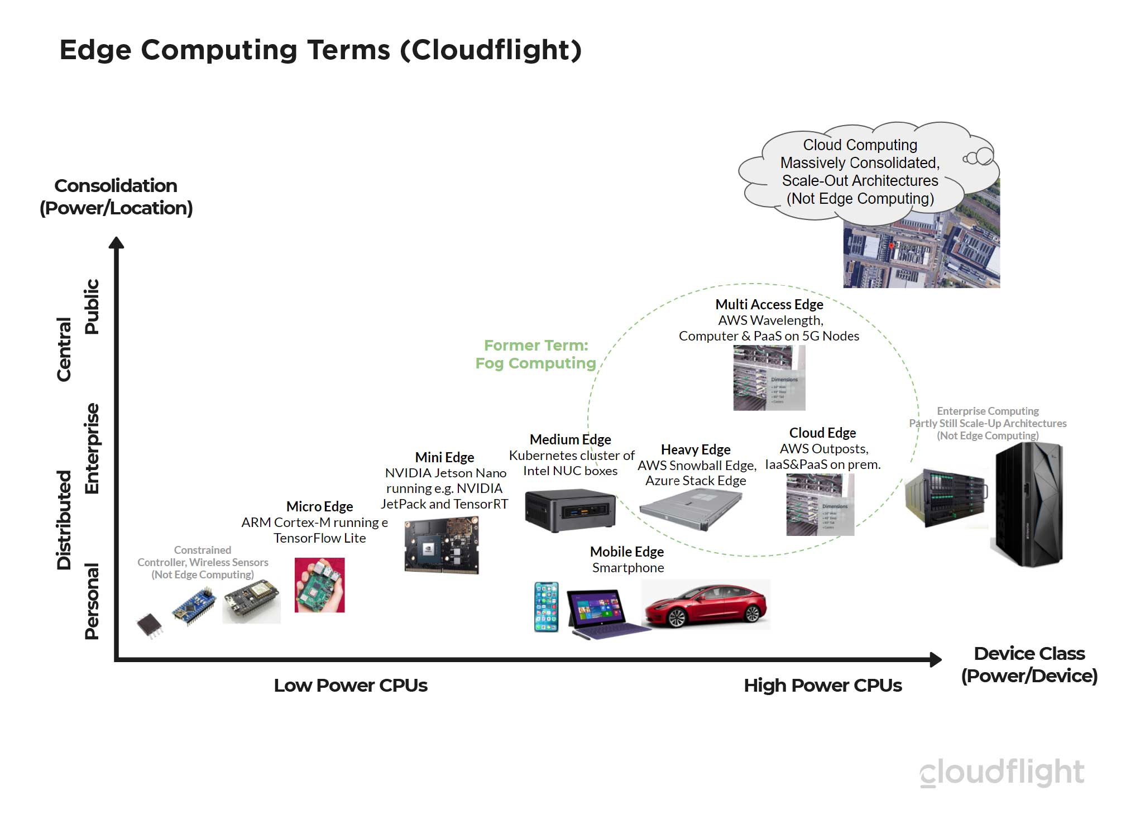
But why?
Edge compute availability is vague
Performance varies across clusters
Consumers lack clear benchmarks
Notes:
Edge computing resources differ in capability, but users often have little visibility into what's available. Performance, latency, and power efficiency can vary significantly across edge clusters. Without clear benchmarks, it's hard to choose the right platform or optimize application deployment. Like for example, there could be clusters nearby that have compute resources like a raspberry pi or it could be all the way up to a massive server.

Slide 6
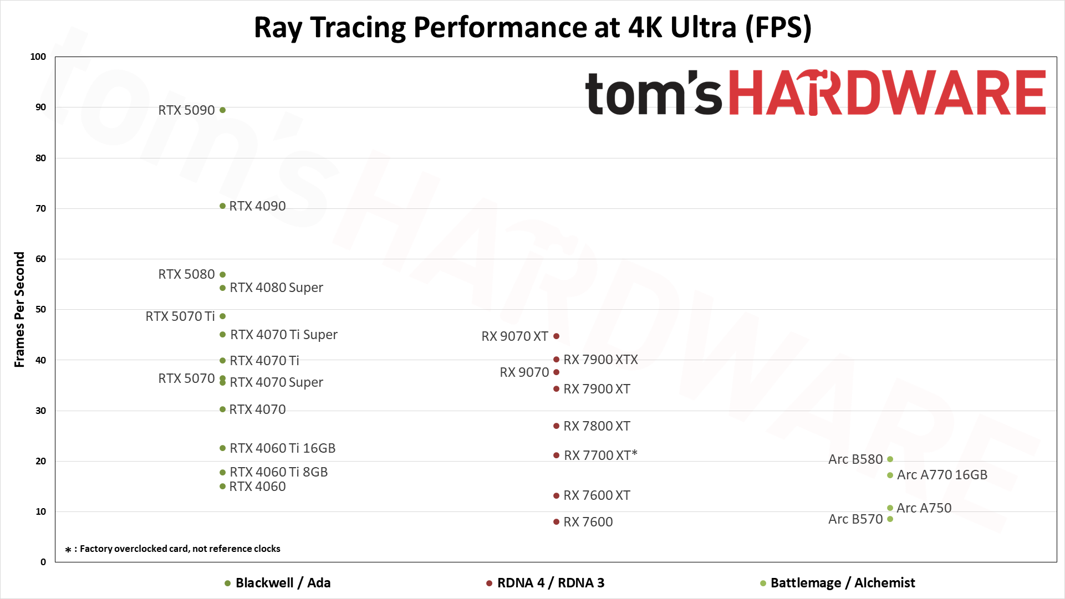
Notes:
For example, in the case of benchmarking the performance of gpus, there is a specific factor of ray tracing at 4k ultra (fps). So we have a very good estimates of what to expect of each gpu when it comes to gaming related to this sector.

Slide 7
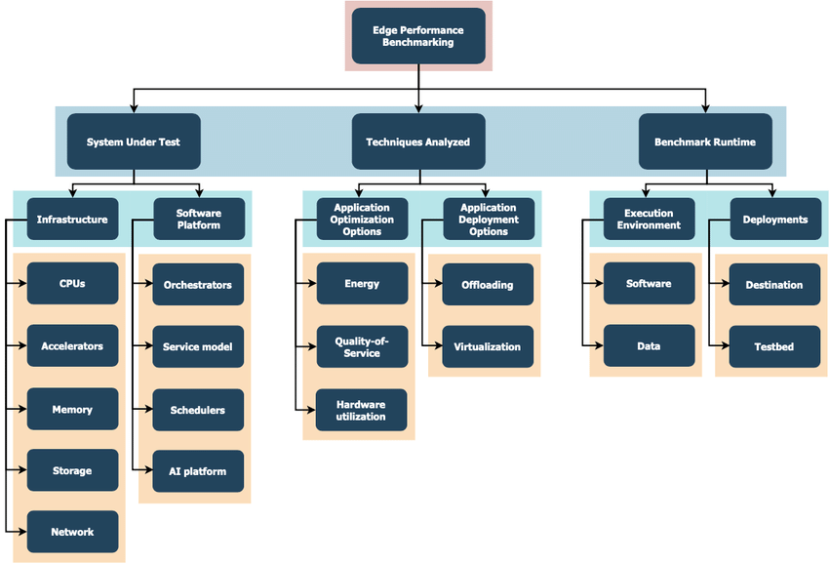
Notes:
In this image, it easier to understand why there is need for a benchmarks for edge computing platforms. Because there are so many factors to consider and prioritize, creating specific benchmark for each cluster, let’s say we take an image of a cat, and I’m not really sure if that’s a cat so when I sent a classification request to edge, I don’t really care about the latency, or I don’t really care more about the energy consumption for the hardware used vs the quality of service for my response. Having these benchmarks will help the scheduler assign the correct requests to the accurate clusters. So that’s why this project is very interesting and pretty essential.

Slide 8
Upcoming Plans
Digest and implement current research related benchmarks corresponding to Edge Platforms
Find limitations or improvements in this paper

